Slide 1


Topic : Domain : Cyber Security Team ID : T186 Team name : SecureSphere Team members : V.HRUTHIKA(2303A51543) B.SAI SPURTHI(2303A51886) R.RUPASRI (2303AA51918) E.SAI ANURATH(2303A51560)
Fake social media accounts and their detection.

Slide 2

Objective
1. Develop a static tool to detect fake profiles on major social platforms.
2. Assist ITBP and national cyber security teams in preventing threats via social media.
3. Forward flagged fake accounts to a central agency for prompt suspension/removal.
4. Provide a secure and efficient model for account verification and threat prevention.

Slide 3
Problem Statement
Rise in fake accounts spreading misinformation and phishing links.
Threat to national security from fake messages targeting ITBP and internal security.
Current reporting systems are manual, slow, and inefficient.
Lack of a centralized verification and reporting mechanism.

Slide 4
Existing system
Component | Current Approach | Limitations
User Reporting | Individuals manually report suspicious accounts | 🔸 Highly subjective, 🔸 Reports often ignored or delayed
Platform Moderation | Internal teams assess reported accounts | 🔸 Overloaded teams, 🔸 Inconsistent action timelines
Verification Systems | Basic verification for public figures only | 🔸No robust tools for mass-user authentication
Government Involvement | Intervene only after major incidents | 🔸 No real-time monitoring, 🔸 Reactive rather than proactive

Slide 5
Proposed system
Use AI/ML-based static tool to flag fake profiles.Highlight its advantages over the existing system.
Analyze profile patterns, account age, content behavior.Use a simple diagram or infographic.
Send reports to a Central Agency Dashboard.
Social media platforms take action within a defined time.

Slide 6
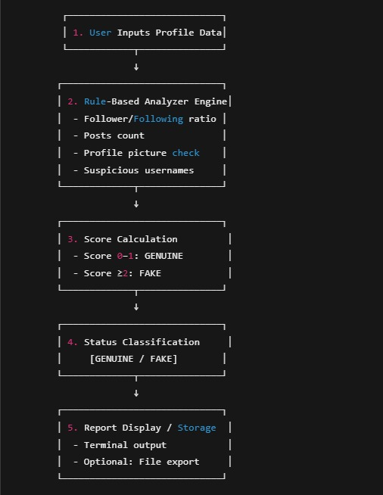
Workflow

Slide 7
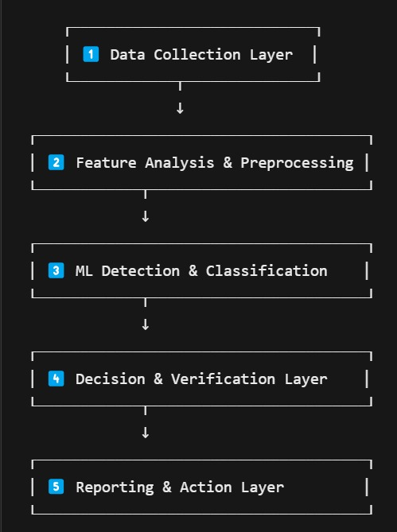
System Architecture
Tech Stack
Languages used ( python)
Data base used
Database securit
Diagram analysis of final Output

Slide 8
Conclusion & Future Scope
✅ Developed a static tool to identify fake profiles ✅ Supports ITBP’s mission for national security ✅ Designed for scalability, central integration, and quick suspension
🔮 Future Scope:
Integration with real-time social media APIs
Extend to messaging apps (e.g., WhatsApp, Telegram)
AI/ML continuous learning for better accuracy
📢 “Empowering Cyber Defence, One Fake Profile at a Time.”

